Slide 1
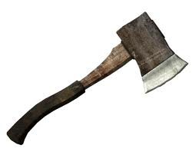
Hatche
Gary Paulsen
Text Exploration

Slide 2
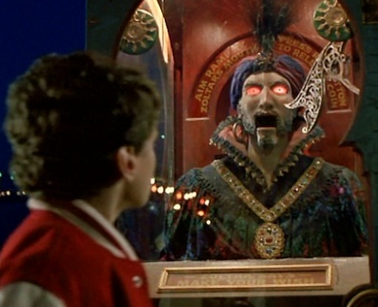
Chapter 8 and 9
Hatchet
Anticipation Response– After reading chapter 7, make one prediction and ask one question that you have.

Slide 3
Chapter 8 and 9
Hatchet
Figurative Language pg.79– Cite one example of figurative language from this page, identify what type it is and illustrate it.
HINT: Personification… ☺

Slide 4
Chapter 8 and 9
Hatchet
Figurative Language pg.79– Cite one example of figurative language from this page, identify what type it is and illustrate it.

Slide 5
Chapter 8 and 9
Hatchet
Context Clues and making a prediction pg.81– “His fingers gingerly touched a group of needles that had been driven through his pants and into the fleshy part of his calf.”
What do you think the word gingerly means and what kind of animal do you think has attacked Brian and why do you believe it is the animal that you have predicted.

Slide 6
Chapter 8 and 9
Hatchet
Textual Evidence ch. 8– “Fire. The hatchet was the key to it all.”
Cite textual evidence that shows how Brian plans to use the hatchet for fire.
.
+
=

Slide 7
Chapter 8 and 9
Hatchet
Context Clues pg.89– “It was painstaking work, slow work, and he stayed with it for over two hours.”
Explain what you think the word painstaking means.

Slide 8
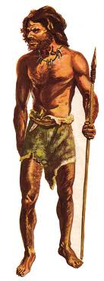
Chapter 8 and 9
Hatchet
Background knowledge pg. 90– “Cro-Magnon man would
have a fire by now- but I don’t know this.”
Meet Cro-Magnon man

Slide 9
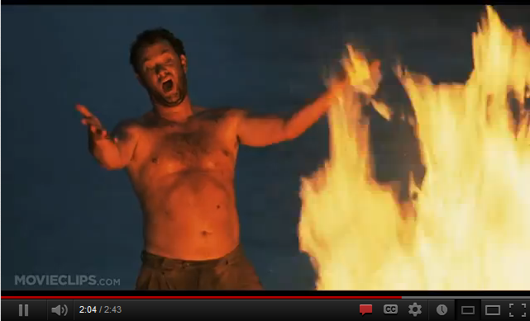
Chapter 8 and 9
Hatchet
In your opinion pg.92– “ ‘Fire!’ He yelled, ’I’ve got fire! I’ve got it, I’ve got it, I’ve got it…’ “
Making fire is a tremendous accomplishment for Brian. Describe in detail a time when you feel like you accomplished something very important.

Slide 10
Chapter 8 and 9
Hatchet
Figurative Language – Cite one example of figurative language from this page, identify what type it is and illustrate it.

