Slide 1
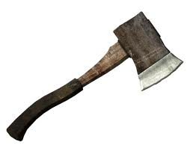
Hatche
Gary Paulsen
Text Exploration

Slide 2
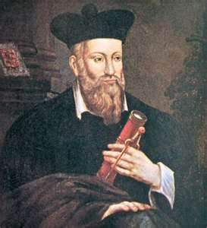
Chapter 7
Hatchet
Anticipation Response– After reading chapter 6, make one prediction and ask one question that you have.

Slide 3
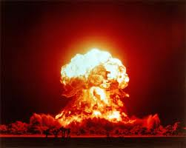
Chapter 7
Hatchet
Figurative Language pg.67– “It was as if all the berries, all the pits had exploded in the center of him, ripped and tore at him.”
Create your own figurative language to illustrate the same as from the book. Then illustrate your figurative language.

Slide 4
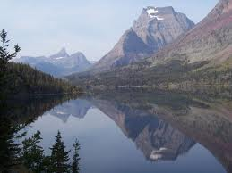
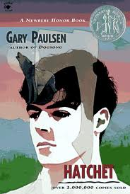
Chapter 7
Hatchet
“It was still very early, only just past true dawn, and the water was so calm he could see his reflection.”
+ =
Brian’s
Reflection

Slide 5
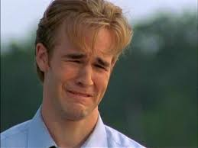
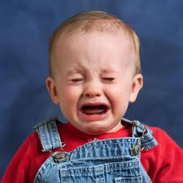
Chapter 7
Hatchet
Making an inference pg.70- “Long tears, self pitty tears, wasted tears.”
Why does Brian believe that his tears are wasted?
POP QUIZ
What famous, 90’s, tv character is this?

Slide 6
Chapter 7
Hatchet
Context Clues pg.70– “He thought of eating some of them. Not such a crazy amount, as he had, which he felt brought on the sickness in the night but just enough to stave off the hunger a bit.”
What does the word stave mean in this context?

Slide 7
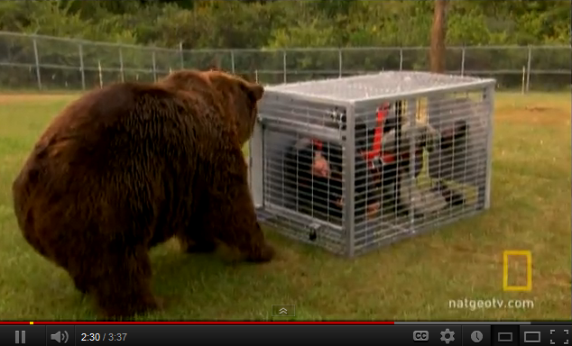
Chapter 7
Hatchet
Background Knowledge pg.74– “He heard a noise to his rear, a slight noise, and he turned and saw the bear.”
Are bears aggressive, could they attack a human?

Slide 8
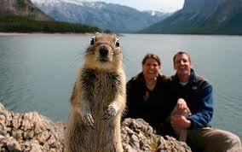
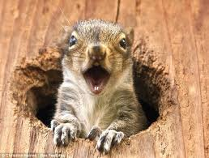
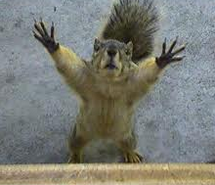
Chapter 7
Hatchet
Figurative Language pg.76– “Once when a squirrel rustled some pine needles at the base of a tree he nearly jumped out of his skin.”
What type of figurative language is this and what is its meaning?

Slide 9
Chapter 7
Hatchet
Textual Evidence ch. 7– Cite 2 examples that Brian is becoming more comfortable with his new surroundings and lifestyle.

