Slide 1
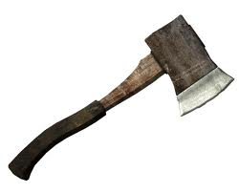
Hatche
Gary Paulsen
Text Exploration

Slide 2
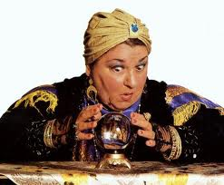
Chapter 6
Hatchet
Anticipation Response– After reading chapters 3 and 4, make one prediction and ask one question that you have.

Slide 3
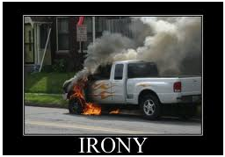
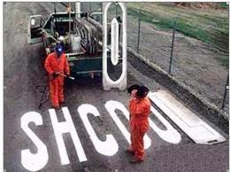
Chapter 6
What is
Irony?
The use of words to convey a meaning that is the opposite of its literal meaning:
Hatchet
Making an inference pg.56– “They pretended that they were lost in the woods and talked in the afternoon about what they would do.”
What is ironic about Brian’s flashback and why?

Slide 4
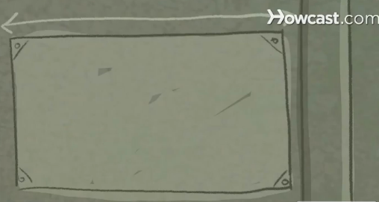
Chapter 6
Hatchet
“They had decided that the best shelter was a lean – to and Brian set out to make one up.
What is a lean – to?
Learn how to make one

Slide 5
Chapter 6
Hatchet
How many of you know your cardinal directions?

Slide 6
Chapter 6
Hatchet
Context clues pg. 58- “Some of the rock that had been scooped out had also been pulverized by the glacial action, turned into sand and now made a small sand beach…”
What does the word pulverized mean in this context?

Slide 7
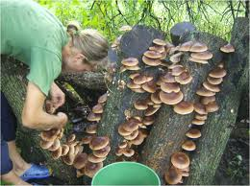
Chapter 6
Hatchet
In your own opinion pg.59– “Before he did anything else he would have to find something to eat.”
What would be the first thing you would try to eat in the wild and why?

Slide 8
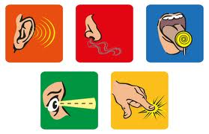
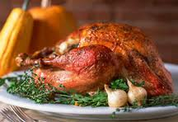
Chapter 6
Hatchet
Sensory details pg. 60– What type of sensory details are being used when Brian is describing his last family Thanksgiving?
Use your own sensory details to describe a big Thanksgiving meal that you have had, Use all 5 senses.

Slide 9
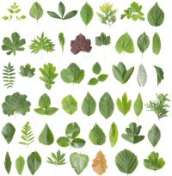
Chapter 6
Hatchet
“Sure the woods were full of berry bushes.”
ALL POISENOUS
BERRY BUSHES

Slide 10
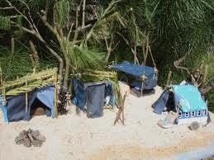
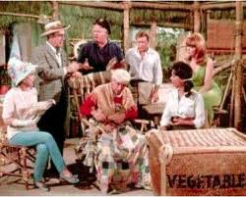
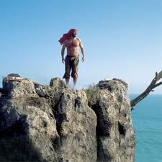
Chapter 6
Hatchet
Background Knowledge- “He almost thought of it as his home.”
Famous Survival Shelters…Can you guess which ones they are?

Slide 11
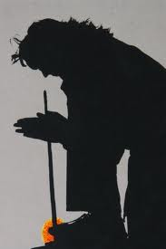
Chapter 6
Hatchet
In your opinion- “How did they used to do it? He thought. Run two sticks together.”
Could you rub two pencils
together to start a fire?

Slide 12
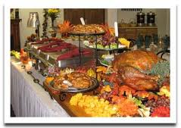
Chapter 6
Hatchet
Figurative language pg.64- “In moments, scattering the birds, grabbing branches, stripping them to fill his mouth with berries.”
Brian is overjoyed to find some food and eats the berries as quickly as he can. Create your own figurative language here to describe Brian as he eats the berries.

