Slide 1
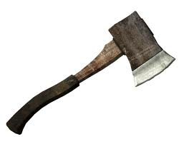
Hatche
Gary Paulsen
Text Exploration

Slide 2
Chapter 5
Hatchet
Anticipation Response– After reading chapters 3 and 4, make one prediction and ask one question that you have.

Slide 3
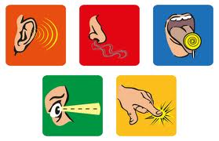
Chapter 5
Hatchet
MINI LESSON
Sensory Details- “His mouth was dry and tasted foul and sticky. His lips were cracked and felt as if they were bleeding…”
Who can explain what sensory details are?

Slide 4
Chapter 5
Hatchet
Cite textual evidence pg.44– Brian is trying to decide if he should drink the lake water or not. CITE ALL textual evidence of him weighing the pros and cons of drinking the lake water.
What does “pros and cons” mean?

Slide 5
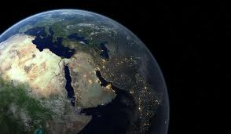
Chapter 5
Hatchet
Figurative language pg.47– “His father and mother would be frantic. They would tear the whole world apart.”
What type of figurative language is this and explain its meaning.

Slide 6
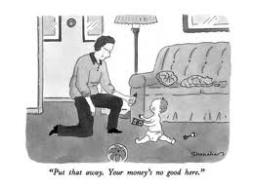
Chapter 5
Hatchet
Identifying Tone pg50- “In case you get stranded at the airport in some small town and you have to buy food.”
What is Brian’s tone in this passage? Also explain the reason for his tone.

Slide 7
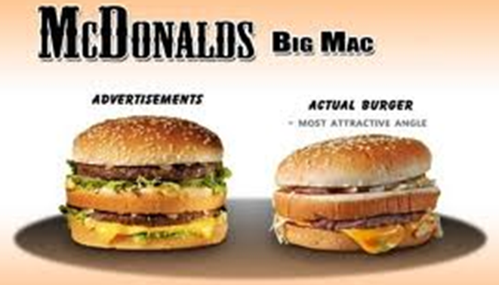
Chapter 5
Hatchet
Compare and contrast“ A mental picture of a hamburger, the way they showed it in television commercials, thundered into his thoughts. Rich colors, the meat juicy and hot…”

Slide 8
Chapter 5
Hatchet
Making an inference pg53- “The plane slewed sideways. What did that mean? Why did that keep coming into his thinking?”
Why do you think that this thought keeps crossing Brian’s mind.

Slide 9
Chapter 5
Hatchet
Background Knowledge- “Oh, yes, the hero usually found some kind of plant that he knew was good toe at and that took care of it.”
Does that sound like good advice?
Let’s hear from an expert

Slide 10
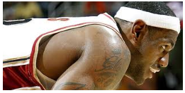
Chapter 5
Hatchet
In your opinion- “I have to get motivated he thought, remembering Perpich.”
If you were in a desperate situation who would you look to for motivation and why?

