Slide 1
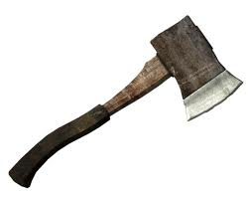
Hatche
Gary Paulsen
Text Exploration

Slide 2
Chapter 3 and 4
Hatchet
Response– After reading chapter 3-4, make one prediction and ask one question that you have.

Slide 3
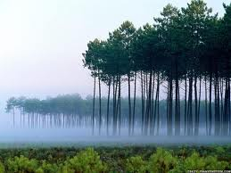
Chapter 3 and 4
Hatchet
Figurative language– “All he saw through the windshield were trees, green death trees.”
What type of figurative language is this and what does it mean?

Slide 4
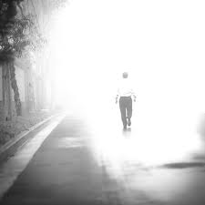
Chapter 3 and 4
Hatchet
Using context clues- “A color came that he had never seen before, a color that exploded in his mind with the pain and he was gone, gone from it all, spiraling out into the world, spiraling out into nothing.”
What do you think has happened to Brian based on this passage?

Slide 5
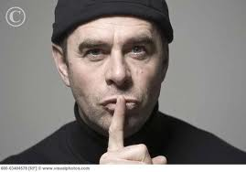
Chapter 3 and 4
Hatchet
Making an inference- “The hot-hate slices of the memory were exact, The Secret.”
What does this mean? Explain!

Slide 6
Chapter 3 and 4
Hatchet
Using context clues- “He pulled the torn remnants of his windbreaker, pieces really, around his shoulders and tried to hold what heat his body could find.”
What do you think that the word remnants means in this sentence?

Slide 7
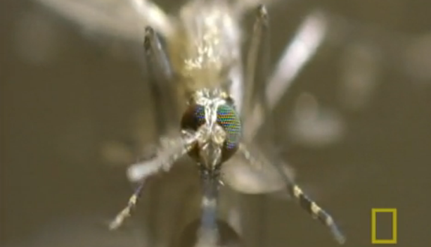
Chapter 3 and 4
Hatchet
“Nobody ever mentioned mosquitos and flies.”
Want to learn more about these vicious creatures?

Slide 8
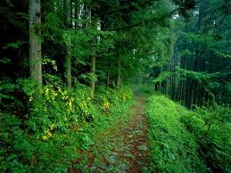
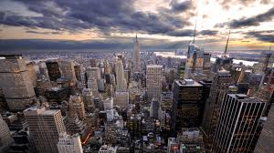
Chapter 3 and 4
Hatchet
Compare and contrast-“He thought it was silent, but when he started to listen, really listen, he heard thousands of things.”
In this scene Brian starts to compare the sights and sound of the forest to the sights and sounds of the city. Below Cite textual evidence of Brian’s comparison.

