Slide 1
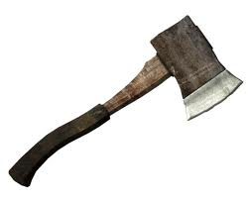
Hatche
Gary Paulsen
Text Exploration

Slide 2
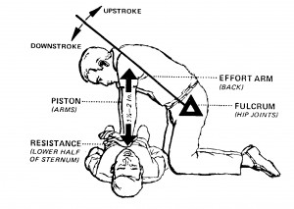
Chapter 2
Hatchet
“He knew there were procedures, that you could do mouth-to-mouth on victims of heart attacks and push their chests –C.P.R.- but he did not know how to do it and in any case could not do it with the pilot.”

Slide 3
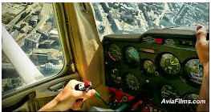
Chapter 2
Hatchet
Making an Inference- Why do you think that Brian is hoping to see a town or village out of the cockpit window?
“He looked out the window for a moment, hoping to see something , a town or village but there was nothing.”

Slide 4
Chapter 2
Hatchet
Want to see a LIVE view from the cockpit?
After watching the film: Give me 6 adjectives and 6
logos that illustrate your adjectives that you think
describe the way that Brian is feeling alone in the cockpit.

Slide 5
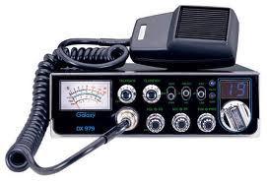
Chapter 2
Hatchet
Using context clues- What type of figurative language is the author using and what is he trying to say about Brian’s situation?
“His own screams mocking him, coming back into his ears.”

Slide 6
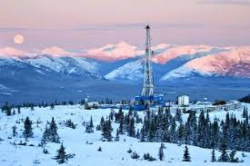
Chapter 2
Hatchet
“Headed for the Canadian oil fields to visit my father.”

Slide 7
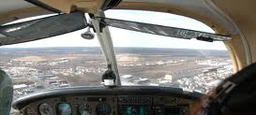
Chapter 2
Hatchet
“Those were his choices. He could wait for the plane to run out of gas and fall or he could push the throttle in and make it happen sooner.”
Faced with Brian’s reality in the airplane, which choice would you make and why would you make that choice?

