Slide 1
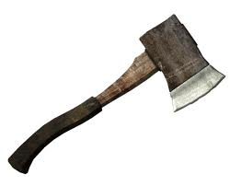
Hatche
Gary Paulsen
Text Exploration

Slide 2
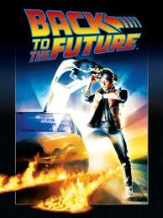
Chapter 18
Hatchet
Anticipation Response– After reading chapter 17 make one specific
prediction and ask one specific question that you have.

Slide 3
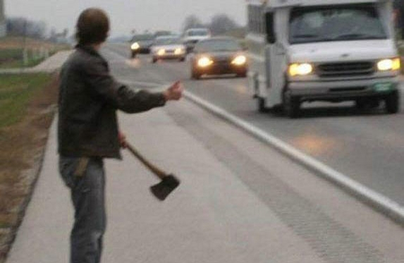
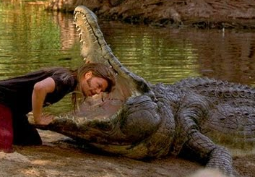
Chapter 18
Hatchet
Making a prediction pg. 174 – Brian is considering using his hatchet to open a hole in the plane and then entering the plane. This is obviously a risky venture, list as many negative outcomes as you can think of.
Other things that are RISKY

Slide 4
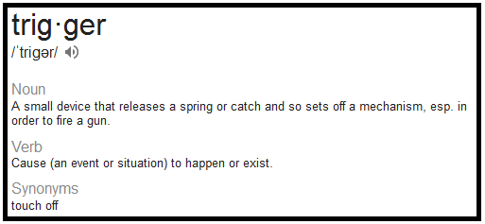
Chapter 18
Hatchet
Context clues pg. 176 – “Bad air triggers were starting to go off in his brain and he knew he was limited to seconds…”
Define the word trigger and use it I a sentence of your own.
Click to reveal the
definition of the word.

Slide 5
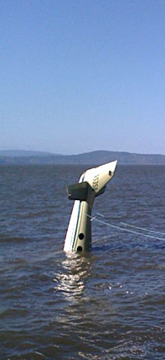
Chapter 18
Hatchet
In your own opinion pg. 179 – “He held back for a moment, uncomfortable with the thought of getting into the plane.” After considering all of the dangers of entering the plane and knowing what dangers Brian has already encountered, explain in detail whether or not you would enter the airplane as it sits in the lake.

Slide 6
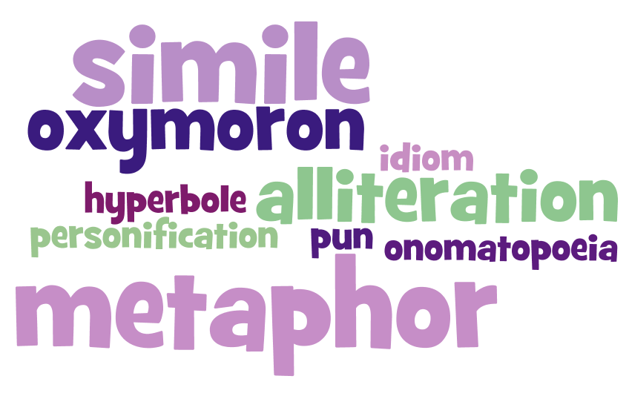
Chapter 17
Hatchet
Figurative Language Chapter 18– Cite your favorite use of figurative language from chapter 18, tell what type of figurative it is and illustrate the figurative language.

