Slide 1
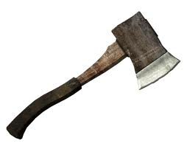
Hatche
Gary Paulsen
Text Exploration

Slide 2
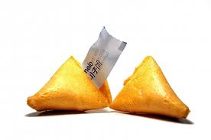
Chapter 17
Hatchet
Anticipation Response– After reading chapter 16 make one specific
prediction and ask one specific question that you have.

Slide 3
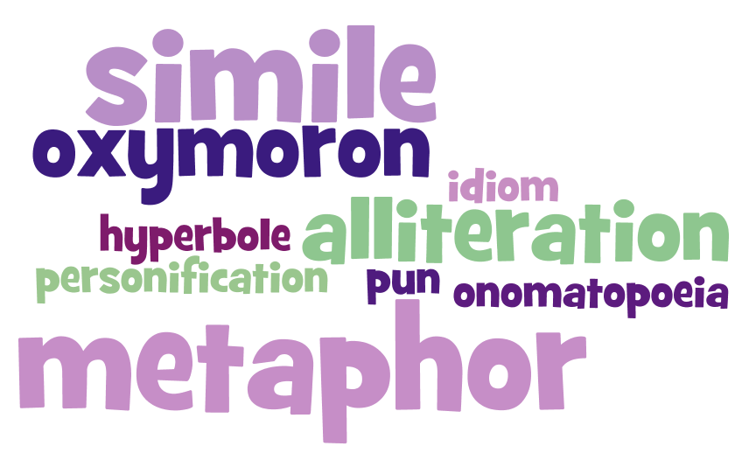
Chapter 17
Hatchet
Figurative Language pg.162– Cite your favorite use of figurative language from this page, tell what type of figurative it is and illustrate the figurative language.

Slide 4
Chapter 17
Hatchet
Context clues pg. 168 – “And for a moment he was stymied. He had no rope, only the bowstring and the other cut shoestring in his tennis shoes.”
Define the word stymied and use it in a sentence of your own.
Click to reveal the
definition of the word.

Slide 5
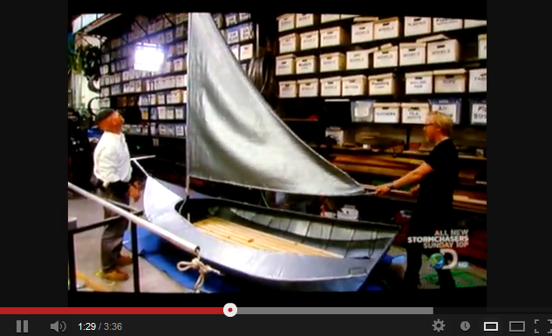
Chapter 17
Hatchet
Background Knowledge pg. 167 – “But at last in the late afternoon he was done and the raft – which he called Brushpile One for its looks – hung together even as he pulled it into the water off the beach.
Brian builds a raft out of brush, what about a raft out of duct tape?

Slide 6
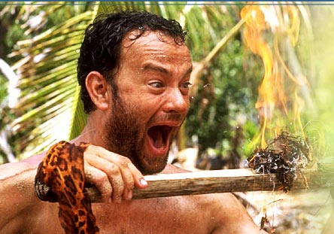
Chapter 17
Hatchet
In your own opinion pg. 170 – Brian is thinking about how life would be when he gets home and whether or not he would miss his life in the wild. If you were in Brian’s position and finally make it home explain in detail how you would feel after returning from living in the wild.
OR

