Slide 1
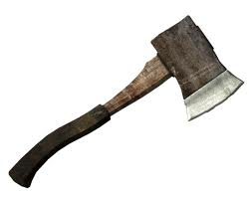
Hatche
Gary Paulsen
Text Exploration

Slide 2
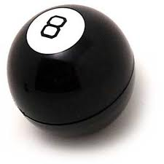
Chapter 16
Hatchet
Anticipation Response– After reading chapter 15 make one specific
prediction and ask one specific question that you have.

Slide 3
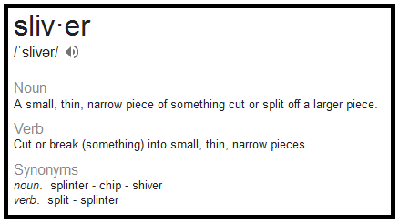
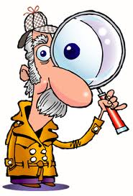
Chapter 16
Hatchet
Context clues pg. 147 – “First Arrow Day—when he had used thread from his tattered old piece of windbreaker and some pitch from a stump to put slivers of feather on a dry willow shaft and make an arrow that would fly correctly.”
Define the word sliver and use that word in a sentence.
Click to reveal the
definition of the word.

Slide 4
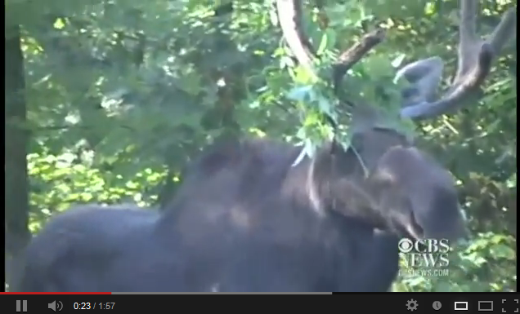
Chapter 16
Hatchet
Understanding the text pg. 150- “He just had time to see that it was a moose – he knew them from pictures but did not know, could not guess how large they were – when it hit him.”
Explain in detail how Brian has become so mentally tough after suffering two devastating setbacks in one day.

Slide 5
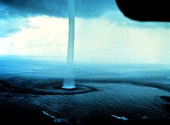
Chapter 16
Hatchet
Understanding the text pg. 156- “It was beautiful and terrible at the same time.”
These two thoughts contradict each other, so explain what the author means in this quote.

Slide 6
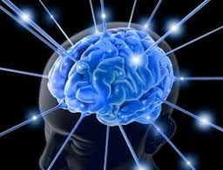
Chapter 16
Hatchet
Understanding the text pg. 157- “Come on, he thought, baring his teeth in t he darkness—come on. Is that the best you can do?”
Explain in detail how Brian has become so mentally tough after suffering two devastating setbacks in one day.

Slide 7
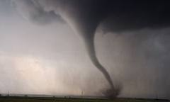
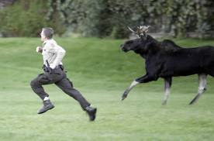
Chapter 16
Hatchet
Citing textual evidence chapter 16 – Chapter 16 if full of excitement and especially danger. Cite textual evidence of the 3 most dangerous events from this chapter.

