Slide 1
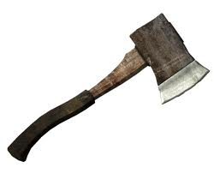
Hatche
Gary Paulsen
Text Exploration

Slide 2
Chapter 15
Hatchet
Anticipation Response– After reading chapter 14 make one specific
prediction and ask one specific question that you have.

Slide 3
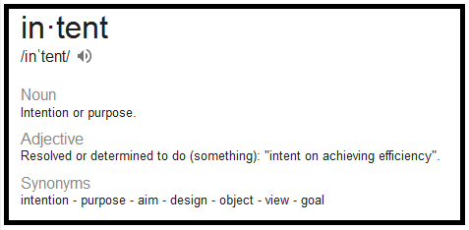
Chapter 15
Hatchet
Context clues pg 138. – “So real, so real. And all a dream, but it left him intent on getting meat.”
Give a short definition of the word intent and use the word in a sentence of your own.
Click to reveal the
definition of the word.

Slide 4
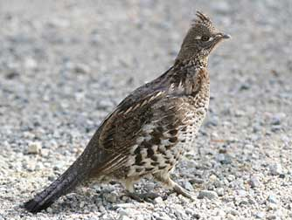
Chapter 15
Hatchet
Tone pg. 140- “It had been there all the time, while he was thinking about how to see them, right next to him—right there. He almost screamed.”
Explain why Brian has become so frustrated and why does he want to scream? Then illustrate how frustrated Brian is becoming.

Slide 5
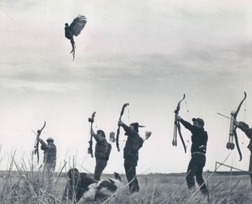
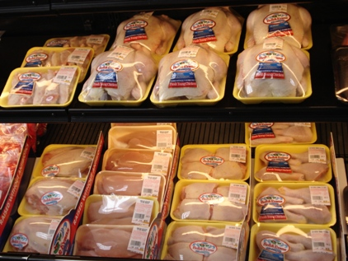
Chapter 15
Hatchet
Citing textual evidence/compare and contrast pg. 142-146. – Cite textual evidence of the author comparing the process of obtaining, cooking and eating chicken in a civilized environment to obtaining, cooking and eating chicken in the wilderness.
VS.

