Slide 1
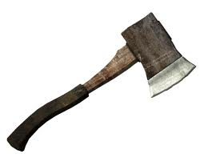
Hatche
Gary Paulsen
Text Exploration

Slide 2
Chapter 14
Hatchet
Anticipation Response– After reading chapter 13 make one specific
prediction and ask one specific question that you have.

Slide 3
Chapter 14
Hatchet
Context clues pg 124. – “Context clues pg 128. – “There was a way to rectify it, make it all right.”
Explain what the word rectify means and why you believe it means this.

Slide 4
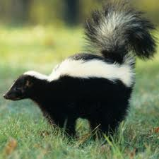
Chapter 14
Hatchet
Understanding the text pg. 130- “He was going to say more, some silly human words…”
Explain the meaning of this quote and why the author chooses to use it.

Slide 5
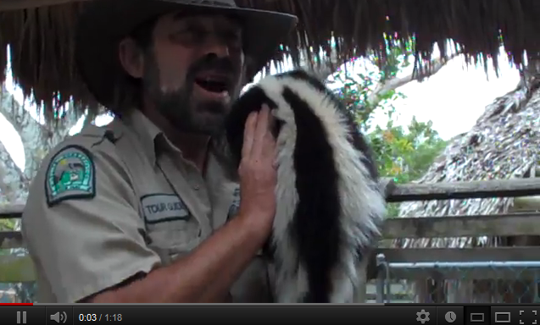
Chapter 14
Hatchet
Background knowledge pg. 130- “The skunk had snapped its rear end up, curved the tail over, and sprayed Brian with a direct shot aimed at his head from less than four feet away.”

Slide 6
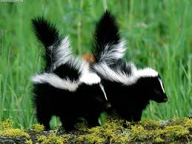
Chapter 14
Hatchet
Figurative Language pg.130-131– “The smell in the shelter, in his clothes and in his hair was still there now almost a month and a half later.”
Create your own figurative
language to describe the
smell.

Slide 7
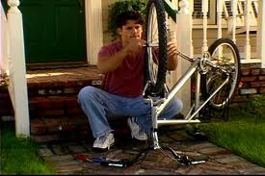
Chapter 14
Hatchet
Tone pg. 134- “Not bad, he thought, not bad for somebody who used to have trouble greasing the bearings on his bicycle. Not bad at all.”
Explain the meaning of this quote and describe the tone that Brian is using.

Slide 8
Chapter 14
Hatchet
Context clues pg 135. – “His fish-trash pile of bones and skin and guts was in the pond area and the prospect of food brought them back.”
Explain what the word prospect means and why you believe it means this

