Slide 1
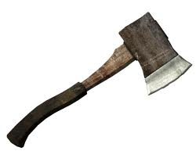
Hatche
Gary Paulsen
Text Exploration

Slide 2
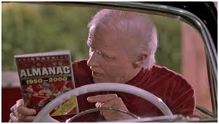
Chapter 13
Hatchet
Anticipation Response– After reading chapter 12 make one specific
prediction and ask one specific question that you have.

Slide 3
Chapter 13
Hatchet
Citing textual evidence pg. 119-120- In these pages, cite textual evidence that proves a long time has passed between Brian missing the chance to signal the plane and where the story is currently. After citing the passages explain how they prove a long time has passed.

Slide 4
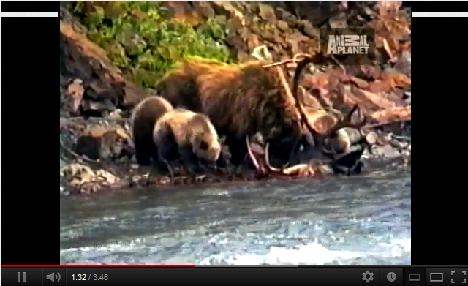
Chapter 13
Hatchet
Background knowledge- “Had he taken two more steps he would have come between the mother and her cubs and that was a bad place to be.”

Slide 5
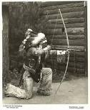
Chapter 13
Hatchet
Figurative language pg. 124 – “At that precise instant the bow wood exploded in his hands sending splinters and chips of wood into his face.”
Create your own figurative language to
improve the previous passage.

Slide 6
Chapter 13
Hatchet
Context clues pg 124. – “It was infuriating. He would pull the bow back, set the arrow just above the water, and when the fish was no more than an inch away release the arrow. Only to miss it.”
Explain what the word infuriating means and why you believe it means this.

Slide 7
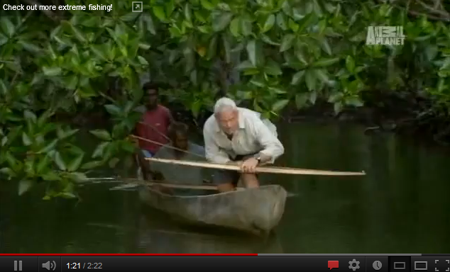
Chapter 13
Hatchet
Background knowledge- “He would not forget his first hit. Not ever.”

Slide 8
Chapter 13
Hatchet
Understanding the text pg.127– “Tough hope, he thought that night. I am full of tough hope.”
Explain the meaning of this quote using 3 examples from the text to prove your argument.

