Slide 1
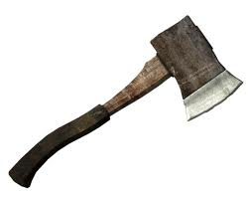
Hatche
Gary Paulsen
Text Exploration

Slide 2
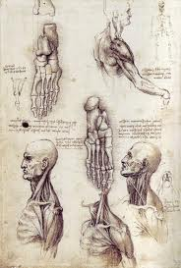
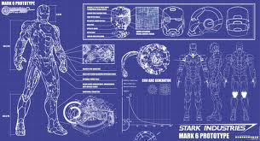
Chapter 10 and 11
Hatchet
Characterization– Brian has had many successes and failures since he has crash landed the plane; all of which have changed him mentally and physically. List as many adjectives that describe Brian’s mental and physical state.

Slide 3
Chapter 10 and 11
Hatchet
Context Clues pg.95– “Brian made certain the fire was banked with new wood, then went out of the shelter and searched for a good fuel supply.”
Explain what you think that the word Banked means and why you believe that is the meaning.
Does it mean the same thing?

Slide 4
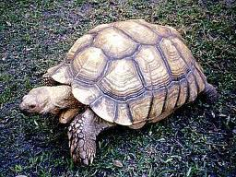
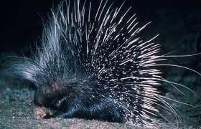
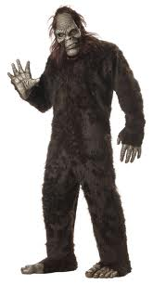
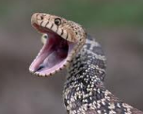
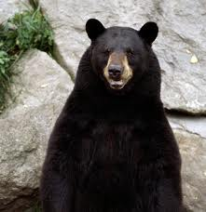
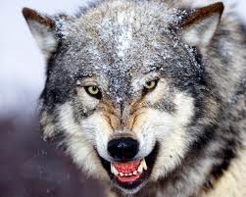
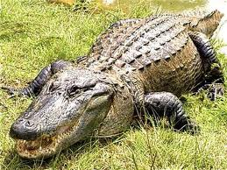
Chapter 10 and 11
Hatchet
Making a prediction pg.98– “It had come up from the water for a reason, a good reason, and he must try to understand the reason, he must change to fully understand the reason himself or he would not make it.”
What do you believe is the animal that had been messing around in the sand and explain why you think it was this animal.
?

Slide 5
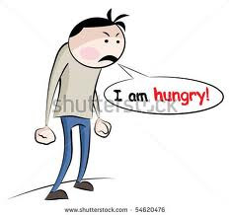
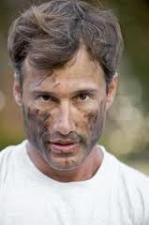
Chapter 10 and 11
Hatchet
Figurative Language pg. 104– “This was completely gone and his stomach had caved in to his hunger and the sun had cooked him past burning so he was tanning, and with the smoke from the fire his face was starting to look like leather.”
Use your own figurative language to describe Brian’s new appearance.

Slide 6
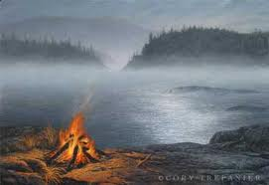
Chapter 10 and 11
Hatchet
Making an inference– “More wood, he thought, moaning inwardly.”
How do you think Brian feels about his new task of creating a signal fire and why do you think he feels this way?

