Slide 2
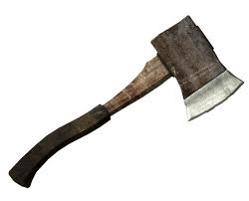
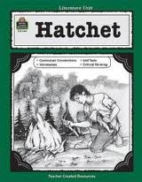
Chapter 1
Hatchet
Anticipation Response- Observe the cover and back of the book. Pay attention to the artwork, author's name and read the summary or reviews. Give me 2 predictions of the book and 2 questions that you have about the book.

Slide 3
Chapter 1
Hatchet
Cessna

Slide 4
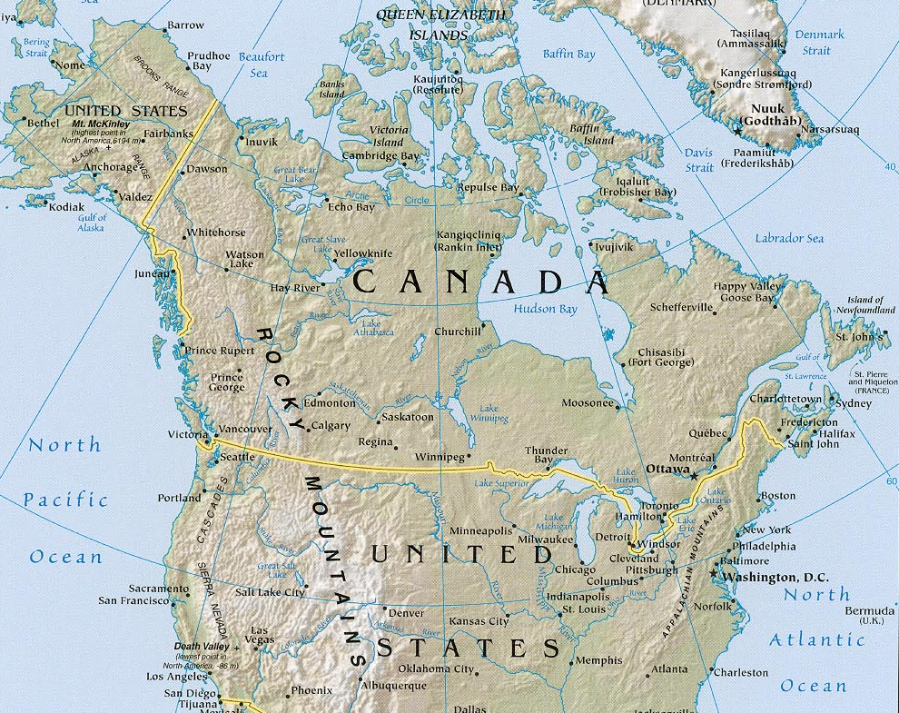
Chapter 1
Looking at the map on the board and citing the text, where do you think that the plane is going?
REMEMBER, citing text requires that you pull the information WORD FOR WORD from the book and put them in quotation marks
Hatchet

Slide 5
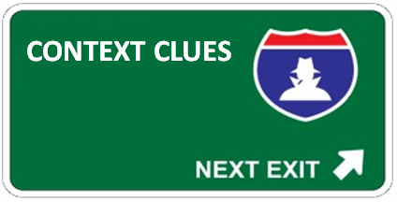
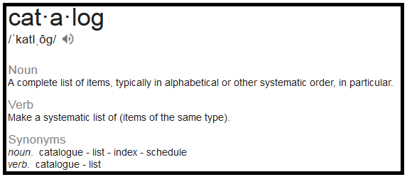
Chapter 1
Hatchet
Using context clues, what do you think that the word catalog means in this sentence?
“Now Brian sat, looking out the window with the roar thundering through his ears, and tried to catalog what had led up to his taking this flight.”
Pg. 2, paragraph 3
Click to reveal the
definition of the word.

Slide 6
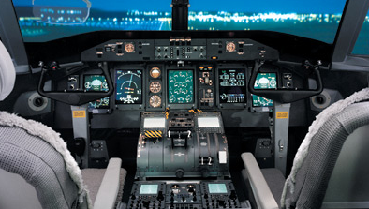
Chapter 1
Use when the pilot lets Brian fly for a little while.
Hatchet
Making a Prediction- Why do you think that the author has the pilot let Brian fly the plane for a bit?

Slide 7
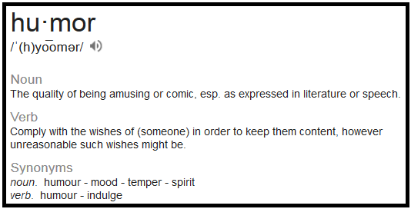
Chapter 1
Hatchet
Using context clues, what do you think that the word humor means in this sentence?
“He still felt bad for not speaking to her, and so to humor her he loosened his belt and pulled the right side out and put the hatchet on and rethreaded the belt.”
Pg. 9, paragraph 1
Click to reveal the
definition of the word.

Slide 8
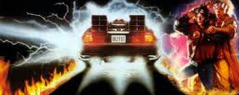
Chapter 1
Use when Brian remembers back to his ride to the airport with his mother.
Hatchet
Making a Prediction- What literary technique does the author use and why is he using it?

Slide 9
Chapter 1
Hatchet
Cite use of figurative language from chapter 1
REMEMBER, citing text requires that you pull the information WORD FOR WORD from the book and put them in quotation marks.
Simile, Metaphor, Hyperbole, Personification, Onomatopoeia, Alliteration, Idiom, Cliché

